Slide 1
Feature Detection and Mapping
ENGR 430 Computer Vision
Matthew Stein
Roger Williams University
With material from
https://opencv-python-tutroals.readthedocs.io/

Slide 2
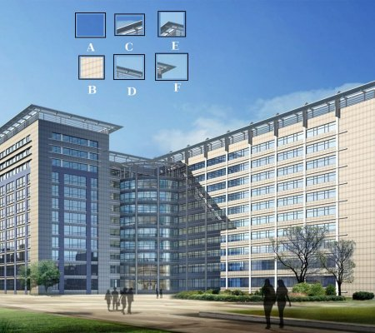
What is a feature?
For insets A-F which can be uniquely located?

Slide 3
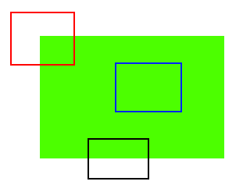
What is a feature?
Blue ↔↕
Black ↔
Red - ✗
First working definition of a feature is a corner
Blobs, etc. can also be features

Slide 4
Harris Corner Detection
Chris Harris & Mike Stephens A Combined Corner and Edge Detector 1988

Slide 5
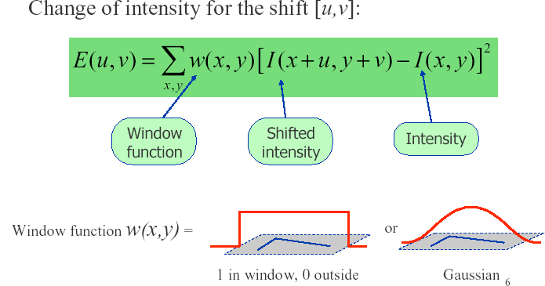
Harris Detector: Mathematics
Robert Collins CSE486, Penn State

Slide 6
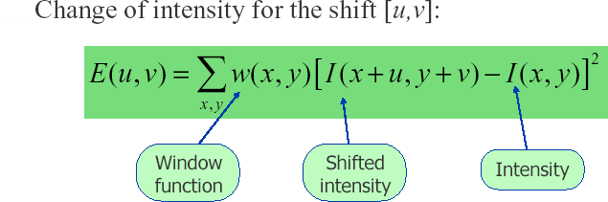
Robert Collins CSE486, Penn State
Harris Detector: Intuition
For nearly constant patches, this will be near 0. For very distinctive patches, this will be larger. Hence... we want patches where E(u,v) is LARGE.

Slide 7
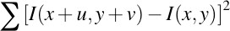
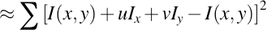
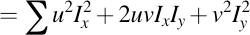
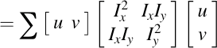
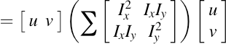
Harris Corner Derivation
Robert Collins CSE486, Penn State
First order approx
Rewrite as matrix equation

Slide 8
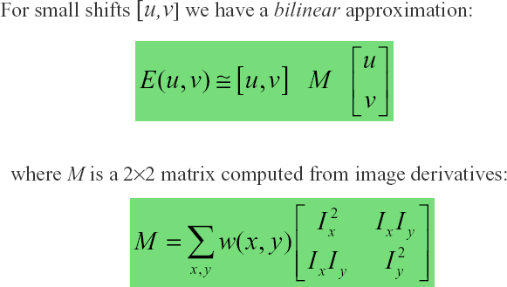
Harris Detector: Mathematics
Robert Collins CSE486, Penn State
Windowing function - computing a weighted sum (simplest case, w=1)
Note: these are just products of components of the gradient, Ix, Iy

Slide 9
Other Edge Detectors (Repeat)
Can build simpler, faster edge detector by omitting some steps:
No nonmaximum suppression
No hysteresis in thresholding
Simpler filters (approx. to gradient of Gaussian)
Sobel:
Roberts:

Slide 10
Sobel Edge Detector (Repeat)

Slide 11
^{CSE486, Penn S}I^{ta}n^{te} tuitive Way to Understand Harris
Treat gradient vectors as a set of (dx,dy) points with a center of mass defined as being at (0,0).
Fit an ellipse to that set of points via scatter matrix
Analyze ellipse parameters for varying cases…
Robert Collins

Slide 12
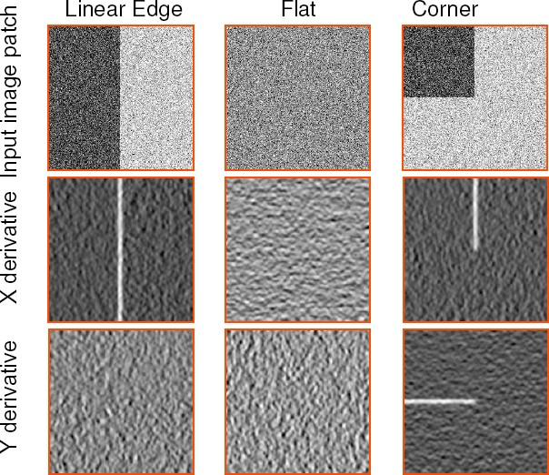
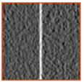
^{CSE486, Penn S}E^{tate}xample: Cases and 2D Derivatives
Robert Collins

Slide 13
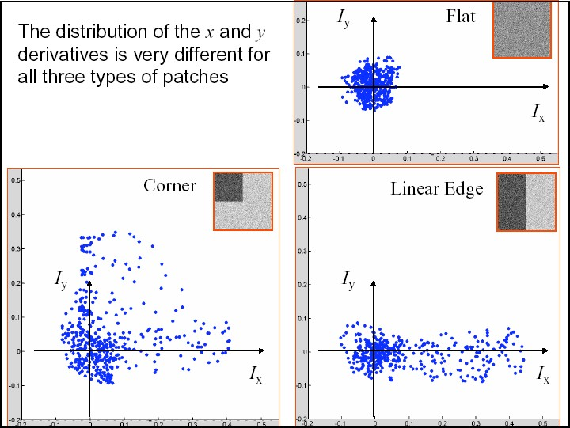
^{CSE486, Penn State}Plotting Derivatives as 2D Points
Robert Collins

Slide 14
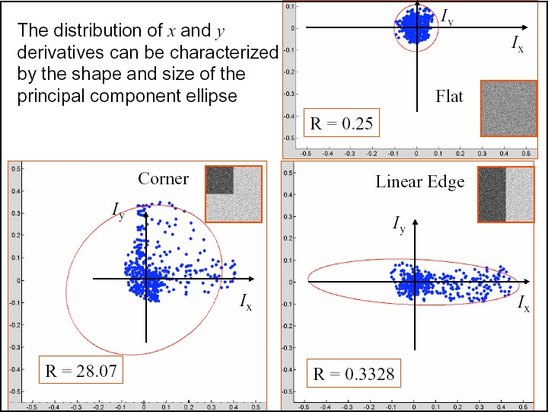
^{CSE486, Penn St}F^{ate}itting Ellipse to each Set of Points
λ1~λ2 = small
λ1~λ2 = large
λ1 large; λ2 = small
Robert Collins

Slide 15
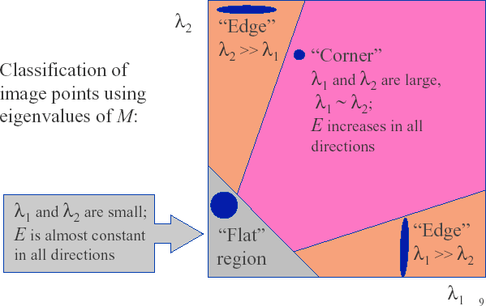
Classification via Eigenvalues
Robert Collins CSE486, Penn State

Slide 16
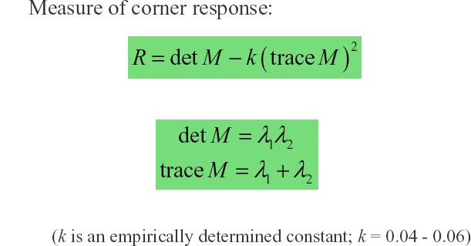
Corner Response Measure
Robert Collins CSE486, Penn State

Slide 17
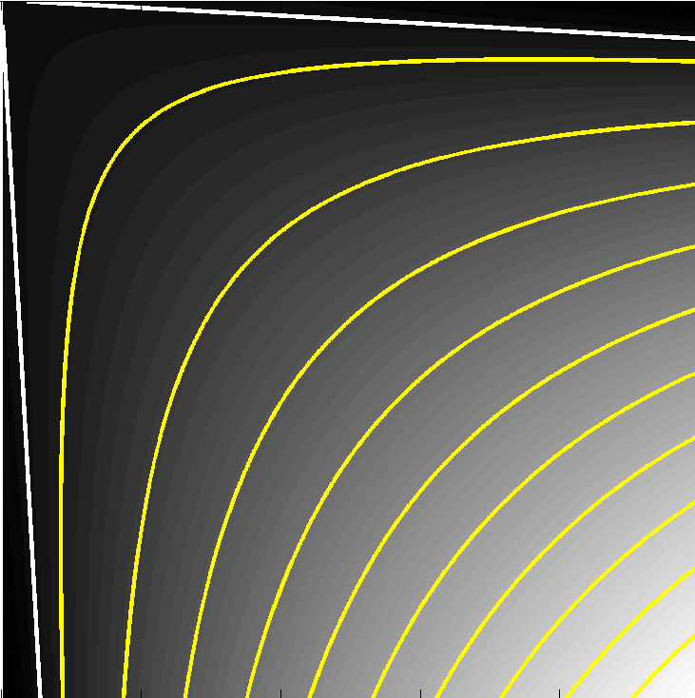

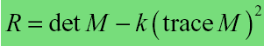
Corner Response Map
lambda1
Robert Collins CSE486, Penn State
(0,0)
R=0
R=28
R=65
lambda2
R=104
R=142

Slide 18
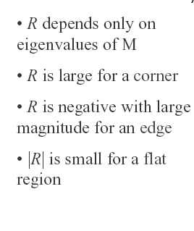
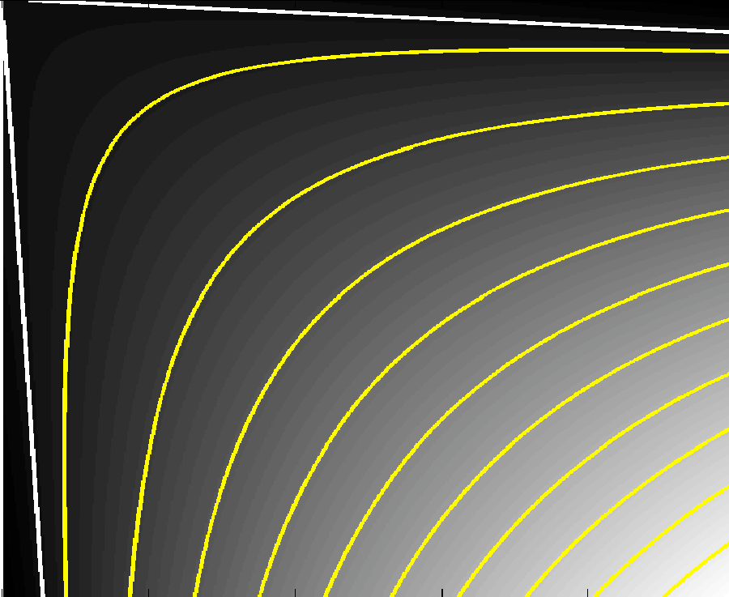
Corner Response Map
Robert Collins CSE486, Penn State
R < 0 “Edge”
lambda1
R=0
|R| small “Flat”
R=28
lambda2
R=65
R=104
R large “Corner”
R=142
R < 0 “Edge”

Slide 19
Let’s try
Pick three interesting points in Building01.jpg
Can use anything (i.e. Paint)
Use Sobel gradient feature in X and Y
Compare images for Blank, Edge and Corner patches

Slide 20
Review Edges vs. Corners
Edges = maxima in intensity gradient
Large changes in intensity over a small range of pixels

Slide 21
Edges vs. Corners
Not enough that there is a large gradient
Corners = large variation in direction of gradient within a small neighborhood

Slide 22
Detecting Corners
How to detect this variation?
Not enough to check average and
Need to know they are both large

Slide 23
Detecting Corners
Claim: the following covariance matrix represents the properties of the gradient Summations over local neighborhoods
fy
fx
fy
fx
fx
fx
fy
fy
fy
fx

Slide 24
Corner Detection Implementation
Compute image gradient
For each m×m neighborhood, compute matrix C
If smaller eigenvalue λ₂ is smaller than threshold τ, record a corner
Nonmaximum suppression: only keep strongest corner in each m×m window

Slide 25
cv2.cornerHarris
OpenCV has the function cv2.cornerHarris() for this purpose. Its arguments are :
img - Input image, it should be grayscale and float32 type.
blockSize - It is the size of neighborhood considered for corner detection
ksize - Aperture parameter of Sobel derivative used, must be odd
k - Harris detector free parameter in the equation.
Check this detectFeature03.py
Try varying parameters detectFeature04.py

Slide 26
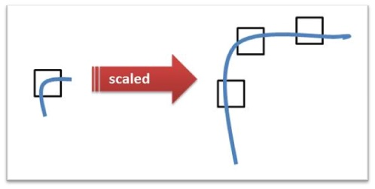
SIFT (Scale Invariant Feature Transform)
Harris corner is not scale invariant
Problematic for moving camera and/or scenes
Insensitive to 4 common types of variance

Slide 27
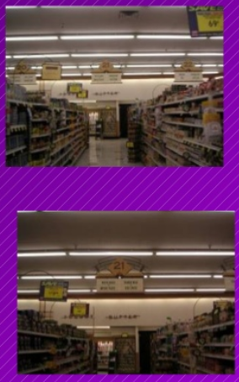
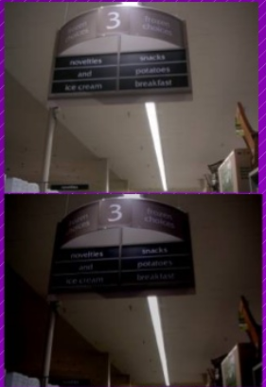
Common Variances
Illumination
Scale
Michal Erel's SIFT presentation

Slide 28
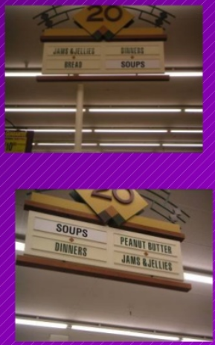
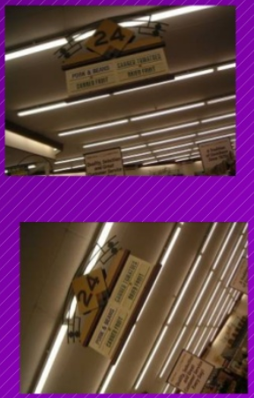
Common Variances
Rotation
Affine
Michal Erel's SIFT presentation

Slide 29
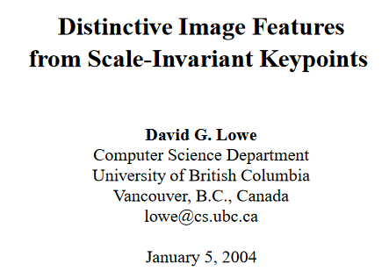
SIFT (Scale Invariant Feature Transform)
4-step process by D. Lowe, 2004

Slide 30
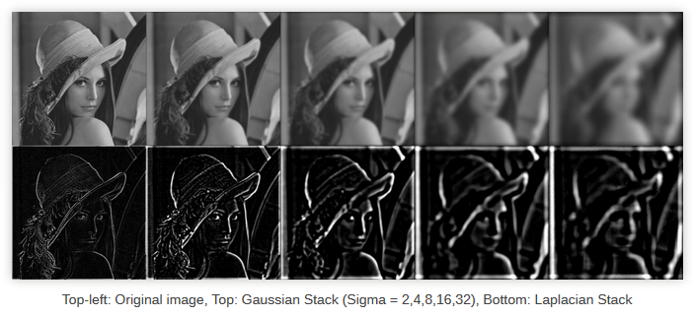
1 Scale-space Extrema Detection
Filter the image with Gaussian filters at increasing octaves of σ

Slide 31
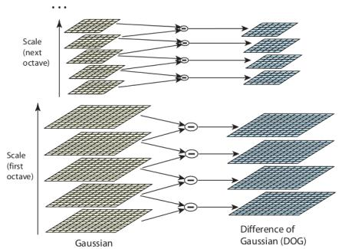
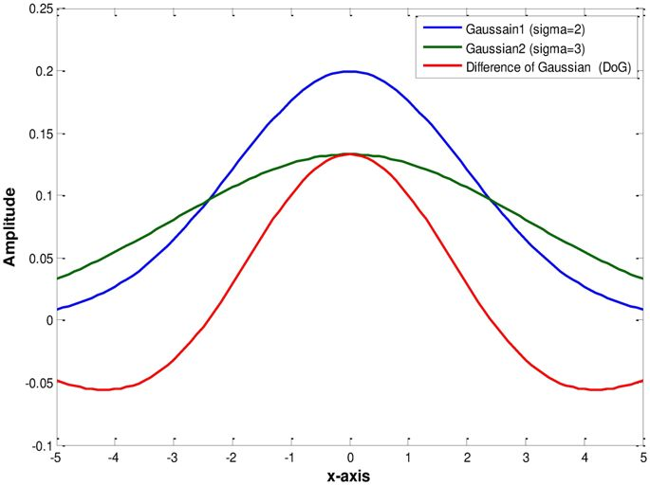
1 Scale-space Extrema Detection
Difference in Gaussian for two successive σ resonates low-high and high-low

Slide 32
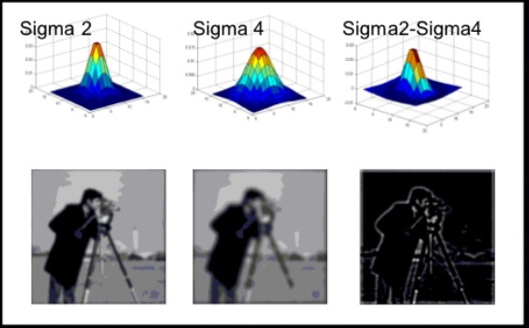
1 Scale-space Extrema Detection
Difference in Gaussian for two successive σ resonates low-high and high-low

Slide 33
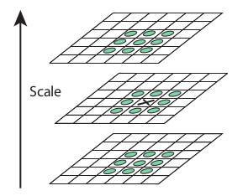
1 Scale-space Extrema Detection
Check adjacent pixels but also neighbors at adjacent octave
Determine local maxima

Slide 34
2 Keypoint Localization
This process will also find edges, so apply Harris-like process to eliminate edges leaving only the corners
Use thresholding to retain only the strongest features

Slide 35
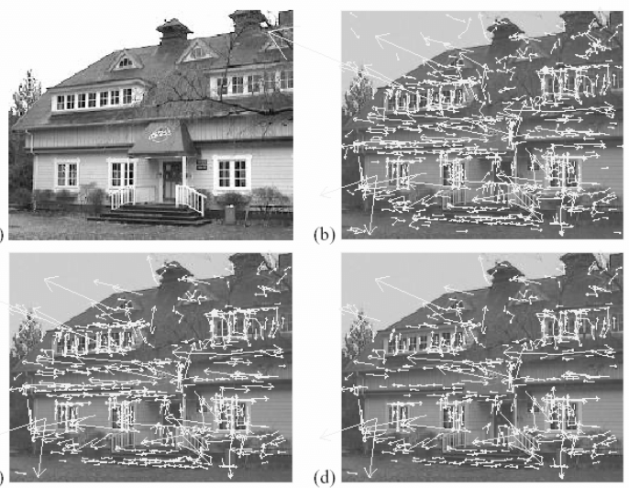
2 Keypoint Localization
832 Keypoints
Eliminate low contrast
Eliminate edge keypoints
729 Keypoints
536 Keypoints

Slide 36
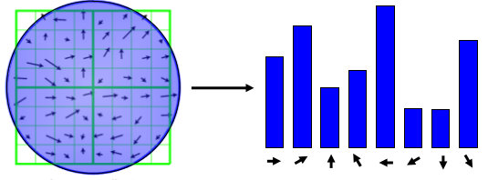
3 Orientation Assignment
For orientation invariance each keypoint is now assigned a dominant orientation
For each blurred version of the image, the gradient magnitude and orientation are computed. From the neighborhood of a keypoint, a histogram of orientations is built (36 bins, 1 bin per 10 degrees).

Slide 37
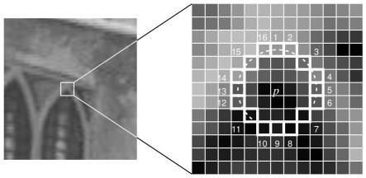
Need to improve speed
FAST Algorithm for Corner Detection
Features from Accelerated Segment Test
Pixel p is a corner if there exists a set of n contiguous pixels in the circle (of 16 pixels) which are all brighter than I_p + t, or all darker than I_p − t. (Shown as white dash lines in the above image). n was chosen to be 12.
Let’s try Fast detectFeature05.py

Slide 38
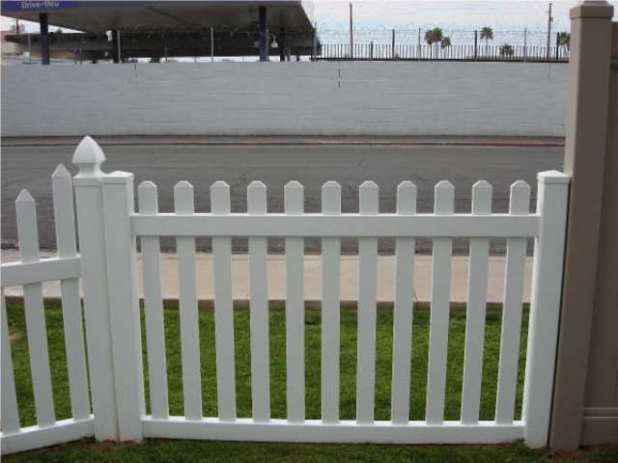
Feature distance
How to define the difference between two features f₁, f₂?
Simple approach is SSD(f₁, f₂)
sum of square differences between entries of the two descriptors
can give good scores to very ambiguous (bad) matches
f₁
f₂
I₁
I₂

Slide 39
How to define the difference between two features f₁, f₂?
Better approach: ratio distance = SSD(f₁, f₂) / SSD(f₁, f₂’)
f₂ is best SSD match to f₁ in I₂
f₂’ is 2nd best SSD match to f₁ in I₂
gives small values for ambiguous matches
f₁
f₂'
f₂
I₁
I₂

Slide 40
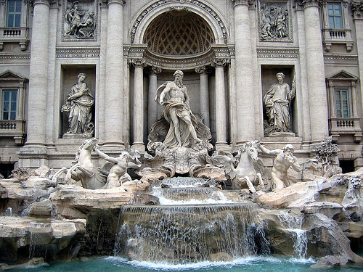
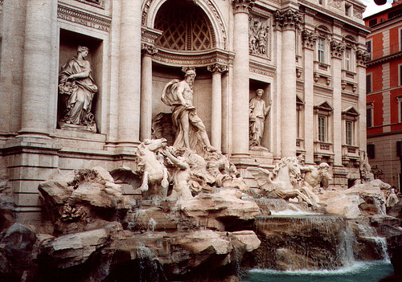
Evaluating the results
How can we measure the performance of a feature matcher?
50
75
200
feature distance

Slide 41
True/false positives
50
true match
The distance threshold affects performance
True positives = # of detected matches that are correct
Suppose we want to maximize these—how to choose threshold?
False positives = # of detected matches that are incorrect
Suppose we want to minimize these—how to choose threshold?
75
200
false match
feature distance

Slide 42
Evaluating the results
How can we measure the performance of a feature matcher?
1
0.7
# true positives
# matching features (positives)
true positive rate
0
1
false positive rate
0.1
# false positives
# unmatched features (negatives)

Slide 43
Evaluating the results
How can we measure the performance of a feature matcher?
ROC curve (“Receiver Operator Characteristic”)
1
0.7
# true positives
# matching features (positives)
true positive rate
0
1
false positive rate
0.1
# false positives
# unmatched features (negatives)
ROC Curves
Generated by counting # current/incorrect matches, for different thresholds
Want to maximize area under the curve (AUC)
Useful for comparing different feature matching methods

Slide 44
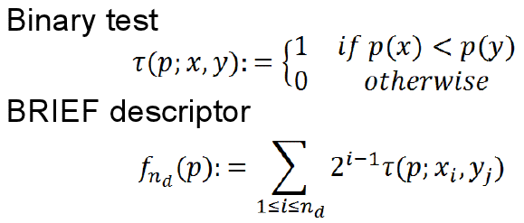

BRIEF descriptor (BRIEF: Binary Robust Independent Elementary Features)
Performs several pair-wise intensity comparisons on a Gaussian-smoothed image patch and encodes the outcomes in a bit vector
The pattern of pixels to be compared by BRIEF in each patch is selected randomly (same for all patches)
BRIEF is less discriminate compared to SIFT but much faster to compute and match, and more compact to store
11010101011001010101010111101100101101010101010111000000111100110101010101010111111010011110101100101110110110110010100
M. Calonder et al. BRIEF: Binary Robust Independent Elementary Features. ECCV 2010.
SEXTANT – TConf1
2012/09/24
Page 44

Slide 45
ORB (Oriented FAST and Rotated BRIEF)
ORB is basically a fusion of FAST keypoint detector and BRIEF descriptor with many modifications to enhance the performance.
First it use FAST to find keypoints, then apply Harris corner measure to find top N points among them.
ORB will “steer” BRIEF according to the orientation of keypoints.
Try on building-> detectFeatures06.py

Slide 46
Matching Features
Fast Library for Approximate Nearest Neighbors (FLAN)
Efficient search of large feature sets
Returns “Nearest Neighbors”, knn returns k nearest neighbors
Try on buildings -> detectFeatures07.py

Slide 47
Summary
Features are best when their location is unique in the image
Take precautions to make features resilient to variances
Eliminate features with poor contrast and along edges
Construct a feature descriptor that encapsulates feature orientation
Compare features in two images by comparing feature descriptors
When multiple possible matches a test of the second best match is less than 70% closer than best match, if so, this is a good feature
Location of feature in one image compared to location in other. If these are not in the same image location deduce the transform between the images.

